Slide 1

Questions and Hints
Roger C. Dugan
Sr. Technical Executive, EPRI
Jacobs Hall, UCSD
Dec 14-15, 2010

Slide 2
How Do You Get Currents and Power If You Only Solve for Node Voltages?
How are the branch currents (and powers) determined when only the Node voltages and Compensation currents are known?
  Currents and powers are determined by post processing
  If the Y matrix is properly formed, the currents will obey Kirchoff’s current law at the nodes
  If convergence is achieved, the powers will be correct

Slide 3
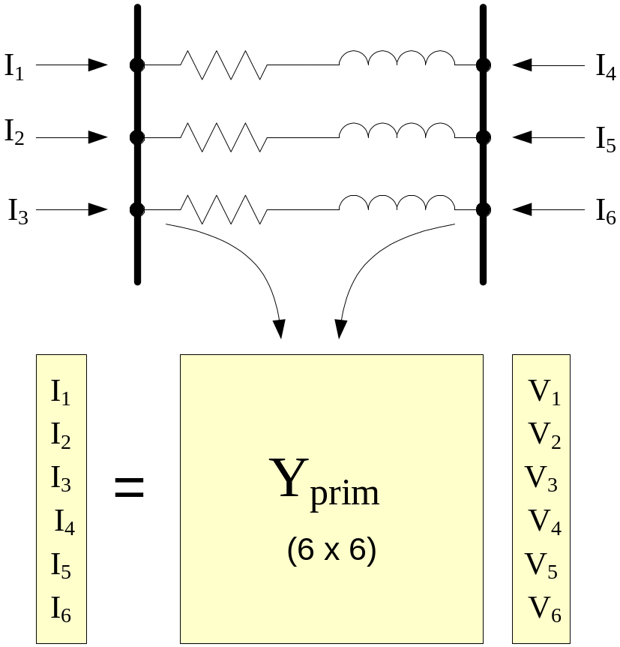
Computing Currents in Branch Terminals (Given the voltages)

Slide 4
Possible Source of Error!
If the branch is extremely short (impedance is very low), currents may be incorrectly computed
  Convergence tolerance is generally 0.0001 pu
  Voltage solution will be good enough
64-bit math is used throughout giving you flexibility
  However, if voltages at both ends of branch are nearly the same, you will be taking the difference between two nearly equal numbers and the multiplying it by a large number (very high conductance)
    This will magnify any error
Do not use impractically short branches

Slide 5
Where Does OpenDSS include Mutual Coupling?
It ALWAYS Includes it!
  All circuit element models provide the DSS executive with an Admittance MATRIX
      That is, every model implicitly has coupled phases
  Units on admittance matrix are actual siemens
    Per units and percent are used for some input and some reports, but not for internal model
    Fewer limitations on the problem that can be represented

Slide 6
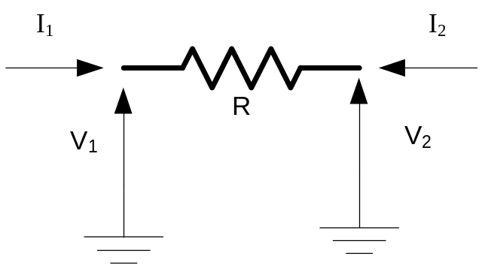
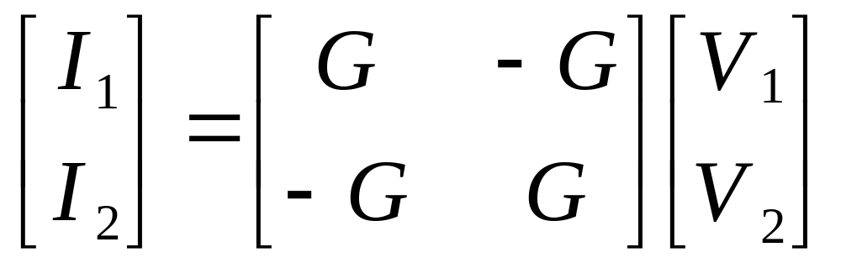
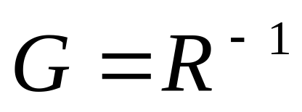
Primitive Y Matrix – A Simple Example
Order of Yprim is
Num Terminals * Num Conductors per Terminal

Slide 7
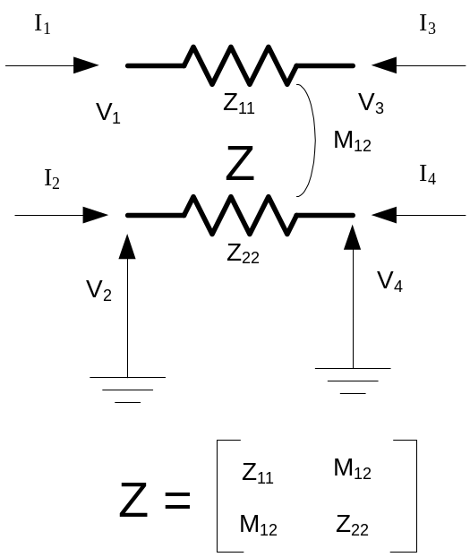
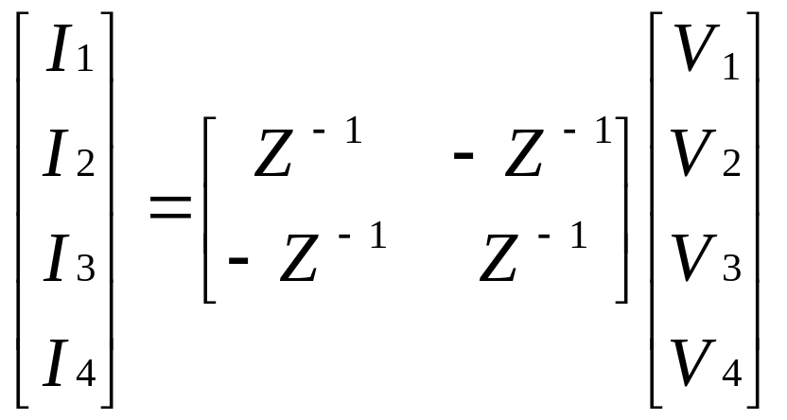
A little more complicated

Slide 8
Yprim
You can obtain the Primitive Y matrix for each element a number of ways (after a Solve)
Dump command
  Dump DSSclass.name debug
    Or, Dump DSSclass.* debug
Script
  Show Yprim ! Of active element
  Export Yprims ! All Yprims
COM Interface
  MyVariant = DSSCircuit.ActiveElement.Yprim

Slide 9
What Kind of Power Flow is the DSS?
The DSS is not a traditional power flow as power engineers tend to think of power flows
  A program with a solution method for fundamental frequency power flow
Its heritage is harmonics analysis and dynamics analysis
  It is a power flow in the sense that you can model loads connected to buses and get a solution that matches traditional power flow programs at 50/60 Hz

Slide 10
What Kind of Power Flow is the DSS?
The “Normal” solution mode is a fixed point iterative solution that works fine for >90% of distribution systems
  Is simple and relatively fast, especially for annual solutions
There is a “Newton” solution method for circuits that are difficult to converge with the Normal method.
  Not to be confused with the traditional Newton-Raphson method in power flow programs
  The Jacobian is the Y matrix, which is not and exact Jacobian, but points in the right direction
    So it is likely to get there eventually

Slide 11
Load and Buses
There is a subtle difference in the way the DSS treats loads that is confusing to traditionally-trained power engineers:
Instead of
  “A Bus has Load”
The DSS has
  “A Load has a Bus”
The latter allows connection of a multitude of different loads and load types to the same bus

Slide 12
Can it solve network systems as well as radial?
The use of the word “Distribution” in the name of the program conjures up ideas of radial circuit solvers in North America (but not necessarily in Europe)
The DSS circuit solver is completely general and has no idea whether the circuit is radial or not.
  This is a requirement for harmonics analysis of distribution systems
The EnergyMeter class is presently the only class that cares about radiality.

Slide 13
Where is the P-V bus type?
Buses do not have special types in the DSS
  Buses are simply connection points for circuit elements
A Generator can control (or attempt to) power and voltage
  (This model can be cantankerous)
This question usually arises with regard to modeling DG on distribution systems
  Fortunately, one seldom needs this model unless the DG is quite large with respect to system capacity
  Most other DG is controlled by Power and Power Factor while interconnected
    Simpler to model

Slide 14
Misc. Hints and Tips, Known Issues, etc.

Slide 15
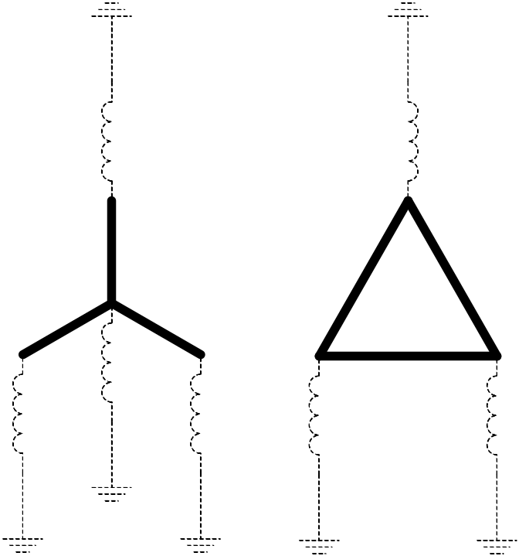
Transformer PPM_antifloat Property
Admittance matrix formulations can suffer from Y matrix singularities if part of the circuit is isolated from ground voltage reference, such as for a floating delta winding. The DSS by default increases the diagonal elements of the Yprim matrix by 1 part in 1 million (1 ppm) which is equivalent to attaching a small reactance to ground at each terminal as shown.
The DSS uses 64-bit arithmetic throughout, so this is usually not a problem with precision.
If you don’t want this, you can set PPM_Antifloat = 0.

Slide 16
Transformer PPM_antifloat Property, cont’d
A common error is to specify a very large transformer (e.g., 1000000 kVA or higher) to represent a very low impedance transformer
This works for the leakage impedance
However, the “small” anti-float reactances are no longer small !!!
  This will sometimes draw more current than the load!
Better approach
  Use a reasonable kVA value and set XHL= small value
  Set PPM_Antifloat = 0 or a small number
    Make sure you can do this without getting floating networks!

Slide 17
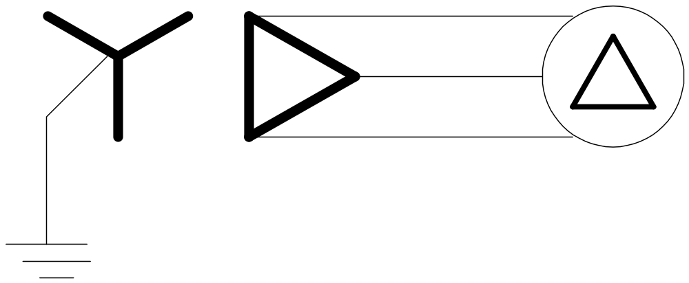
Wye-connected Generator
Sometimes the normal power flow will not converge well for direct-connect Y-connected DG.
Workaround:
Set
Xd’_{model} = Xd’ - X₀
Xd”_{model}= Xd” - X₀
Model DG as Delta-connected generator behind Y-Delta transformer
Set XHL = X₀ of DG

Slide 18
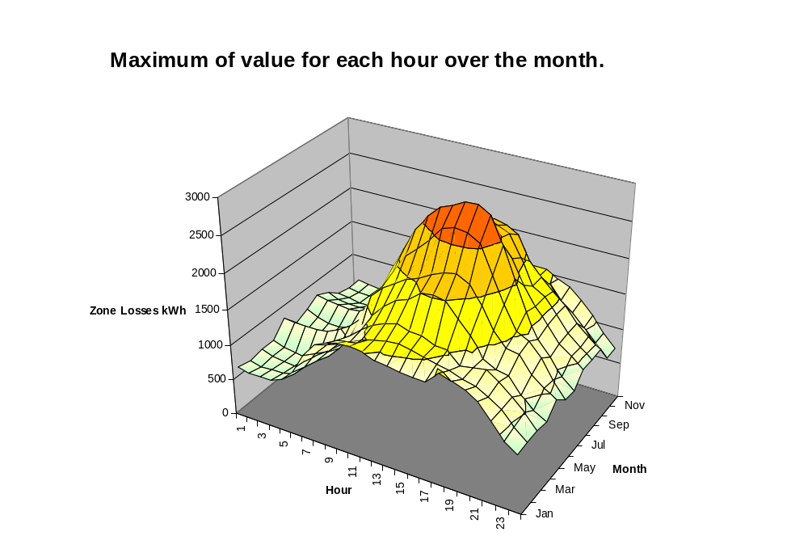
How Do I Make One of Those 3-D Plots?
We call this an “E-3” plot after the San Francisco economics firm who taught us how to do it (see http://ethree.com)

Slide 19
Procedure for 3D Annual Plot
Run an annual simulation (Set Mode=Yearly)
Turn on the Demand Interval feature of the EnergyMeter object
  Or, simply use a Monitor object
Import the resulting CSV file into MS Excel where a 3-D plot has been defined
(See SampleDSSDriver-3D.XLS for an example macro for importing a field from a CSV file.)

Slide 20
Annual Simulation Script
set casename=MyCaseName ! This will be the folder name + year number
set mode=yearly ! Sets Number=8760, 1 hr time step, resets meters
! Set "DemandInterval" to true so that energy quantities recorded by energy meters are recorded for
! each time step and set "casename" to define a directory under default directory in which all of the
! demand interval data is recorded. (NOTE: Setting DemandInterval=true resets all energymeters.)
Set overloadreport=true ! TURN OVERLOAD REPORT ON (optional)
Set voltexcept=true ! TURN VOLT Exception REPORT ON
set DemandInterval=true ! Capture demand interval data
set DIVerbose=true
Set Year=1
solve
Set Year=2
solve
Closedi ! Do this after final year

Slide 21
Executing Part of Annual Simulation
set casename=MyCaseName ! This will be the folder name + year number
set mode=yearly ! Sets Number=8760, 1 hr time step, resets meters
! Set "DemandInterval" to true so that energy quantities recorded by energy meters are recorded for
! each time step and set "casename" to define a directory under default directory in which all of the
! demand interval data is recorded. (NOTE: Setting DemandInterval=true resets all energymeters.)
Set overloadreport=true ! TURN OVERLOAD REPORT ON (optional)
Set voltexcept=true ! TURN VOLT Exception REPORT ON
set DemandInterval=true ! Capture demand interval data
set DIVerbose=true
Set Year=1
Set hour=5000 ! Start at hour 5000 into loadshapes
solve Number=168 ! Solve one week; redefine Number
Closedi ! Do this after final year

Slide 22
Demand Interval Files
After an annual simulation, the results are saved in the directory structure as a collection of CSV files
Circuit Root
CaseName
DI_yr_1
DI_yr_2
DI_yr_3
DI_yr_4
DI_yr_N

Slide 23
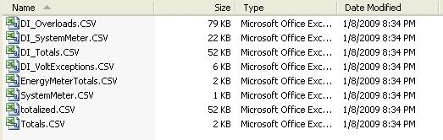
Inside a DI_Yr_nn Directory
The results are saved as a series of CSV files.
(one week simulation)

Slide 24
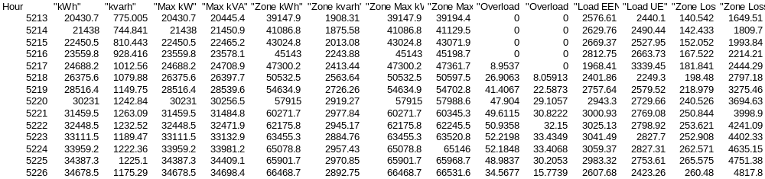
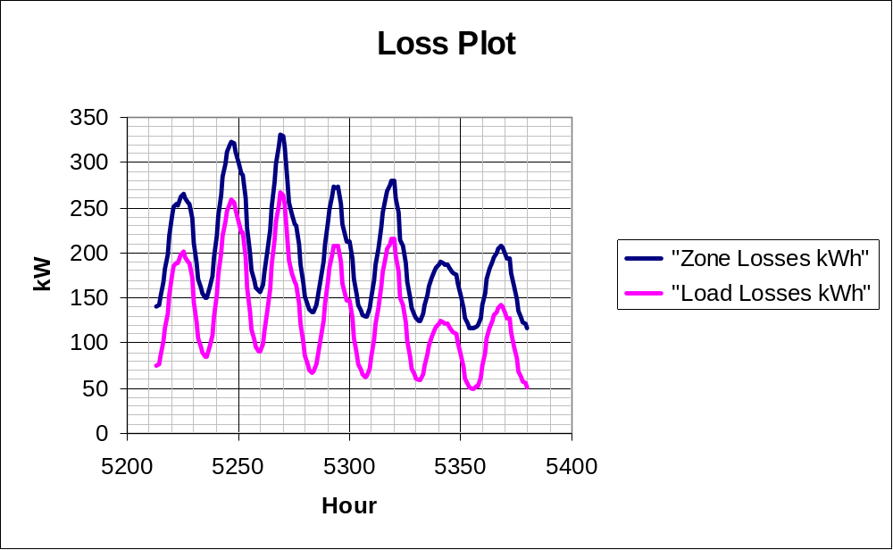
Snip from CSV file loaded into Excel

Slide 25
Enable/Disable
Once a circuit element is defined in a script, it can be
  Enabled (default)
  Disabled
  Redefined (Edit)
Use Enable/Disable to temporarily add or delete elements from the circuit
Enable/Disable Commands
  Disable Line.Line1
  Line.Line1.Enabled = No
  Edit Line.Line1 …. Enabled=No

Slide 26
Open/Close
You can open any terminal of any device that is active in the circuit:
  Open Line.Line1 2 (opens Terminal 2)
  Open Line.Line1 2 3 (opens phase 3 of terminal 2)
Caveat: Voltage at open terminal is inaccessible (does not exist)
Alternative:
  Line.Line1.Bus2=Term2_Open
    Redefine Bus2 to another bus with nothing else
    “Term2_open” voltage is accessible

Slide 27
Load Models (Present version)
1:Standard constant P+jQ load. (Default)
2:Constant impedance load.
3:Const P, Quadratic Q (like a motor).
4:Nominal Linear P, Quadratic Q (feeder mix). Use this with CVRfactor.
5:Constant Current Magnitude
6:Const P, Fixed Q
7:Const P, Fixed Impedance Q

Slide 28
Standard P + jQ Load Model
When the voltage goes out of the normal range for a load the model reverts to a linear load model
  This generally guarantees convergence
    Even when a fault is applied
  To change break points to +/- 10%:
    Load.Load1.Vmaxpu=1.10
    Load.Load1.Vminpu=0.90
  Note: to solve some of the IEEE Radial Test feeders and match the published results, you have to set Vminpu to less than the lowest voltage published

Slide 29
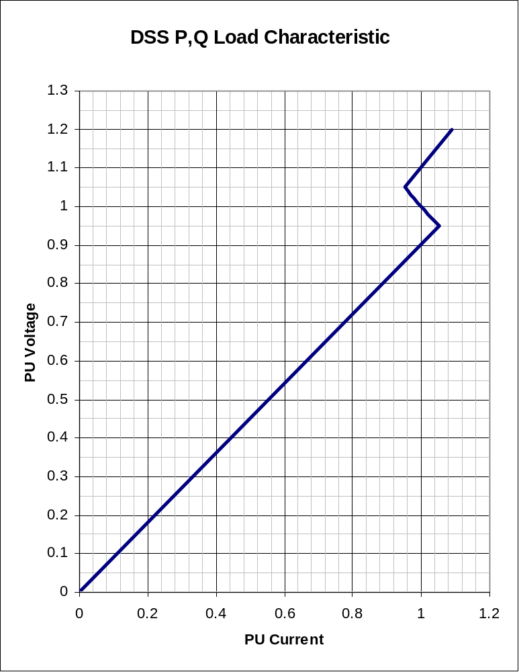
Standard P + jQ Load Model (Model=1)
Const Z
105%
(Defaults*)
95%
|I| = |S/V|
Const Z
* Change by setting Vminpu and Vmaxpu Properties

Slide 30
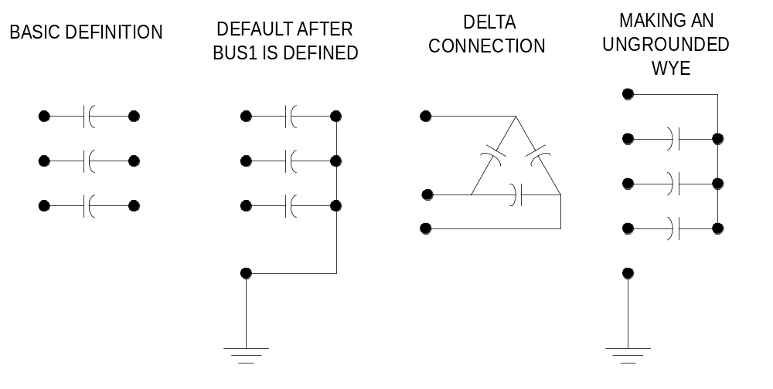
Two Terminal Caps, Reactors, Faults
Capacitors, Reactors, and Faults are special 2-terminal PDElements with special defaults for bus connections
Bus1 = B1
Bus2 = B2
(Series Connection)
Bus1=B1
(Bus2 is ignored)
Bus1 = B1
Bus2 = B1.4.4.4
Bus1=B1
(BUS2=B1.0.0.0) (default)

Slide 31
Common Errors

Slide 32
A Bus’s Life
In contrast to other power system analysis programs,
Bus objects do not exist until required
These commands will force building of the bus list
  Solve
  CalcVoltageBases
  MakeBusList
The Bus List is built from the currently enabled devices
Editing circuit element properties often requires rebuilding the bus list
  If no changes, the Bus List is not re-built

Slide 33
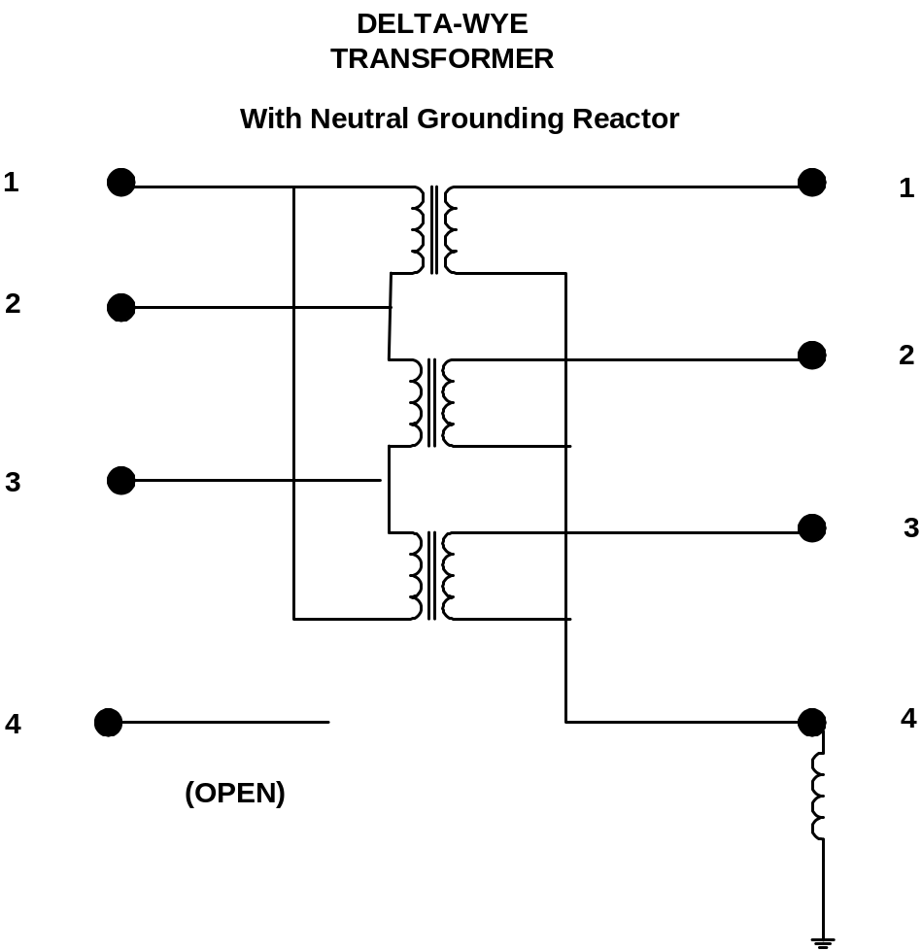
Specifying Transformer Neutral Reactor
What’s Wrong With This?
New Transformer.T1 phases=3 Wind=2
~ Buses=[DeltaBus WyeBus]
~ Conns=[Delta Wye]
~ kVAs=[10000 10000]
~ kVs=[115 12.47]
~ Wdg=2

Slide 34
Specifying Transformer Neutral Reactor
What’s Wrong With This?
New Transformer.T1 phases=3 Wind=2
~ Buses=[DeltaBus WyeBus]
~ Conns=[Delta Wye]
~ kVAs=[10000 10000]
~ kVs=[115 12.47]
~ Wdg=2
Expands to
WyeBus.1.2.3.0
Shorts The Reactor !!!

Slide 35
Line Length and Distance from Meter
Distance from the upstream meter is accumulated for each branch and bus as the meter zone is traced
The Length= and Units= properties of the Line definition are used to convert the length to km
Problem: Unit-less lines
  Line impedance may be computed by entering the impedance value in actual ohms and setting the length=1.
  However, this will be interpreted as a 1 km line!!
    Usage of the distance value will be suspect
Distance is available from the COM Bus interface

Slide 36
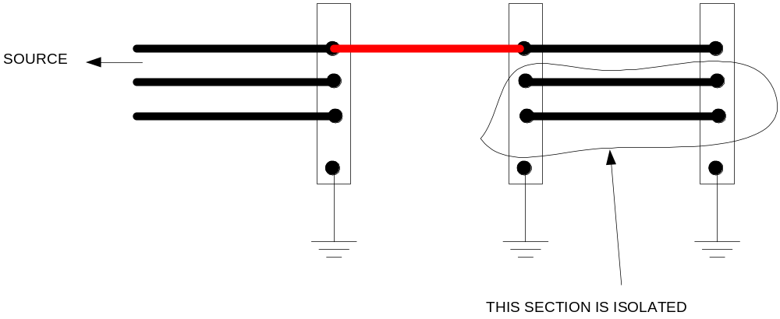
Single-Phase to 3-phase Line
Diagnosing: This may cause a floating point error in normal snapshot power flow.
1) Look at voltage after CalcVoltageBases
2) Do Solve Mode=Direct; then look at voltages (Show Voltage LN Nodes)

Slide 37
Wrong Voltage Base on Load or Generator
Don’t forget to specify “kv=…” property!
3-phase Load
New Load.Load1 Phases=3 Bus1=B1 kV=12.47 kW=100 PF=.95
3 Single-phase Loads
New Load.Load1a Phases=1 Bus1=B1.1 kV=7.2 kW=33.33 PF=.95
New Load.Load1b Phases=1 Bus1=B1.2 kV=7.2 kW=33.33 PF=.95
New Load.Load1c Phases=1 Bus1=B1.3 kV=7.2 kW=33.33 PF=.95
Make sure these have different names

Slide 38
A Tricky One – Sequence dependencies
Compile xxxx
Set VoltageBases=[12.47 .48 .208]
CalcVoltageBases
! Now define energymeter to get voltage base register
New EnergyMeter.Main Line.Line1 1
Reconductor Line50 Line60 LineCode=795ACSR
Causes an error that says Line50 and Line60 not in a meter zone or not in same meter zone
Why?
Nothing has happened since the definition of the EnergyMeter object to force it to compute its zone.
Resolution:
Issue Solve or MakeBusList to force meterzone. Then issue Reconductor

Slide 39
Together…Shaping the Future of Electricity

